Slide 1

Unit – 2 Selections , Mathematical
functions and loops
Prepared By
Prof. Ravikumar R N
Assistant Professor, CE Dept.

Slide 2
Selections
If Statement
Two way if-else statement
Nested if and multi-way if else statement
Switch statement :
switch (switch-expression) {
case value1: statement(s);
break;
……. default : statement;
}
Conditional Expression (Ternary) :
boolean-expression ? expression1 : expression2;

Slide 3
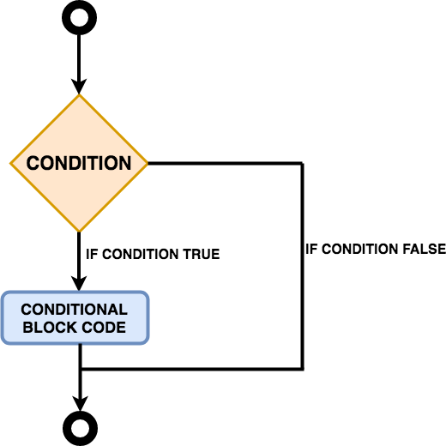
If Statement
The Java if statement tests the condition. It executes the if block if condition is true.
Syntax:
if(condition){
//code to be executed
}
Check Program: Unit – 2 → IfDemo.java

Slide 4
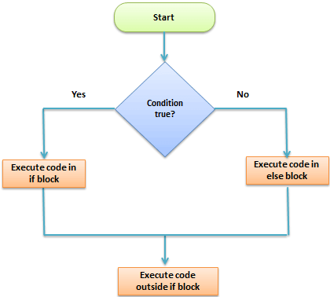
Two way If ( if.. else Statement )
The Java if-else statement also tests the condition. It executes the if block if condition
is true otherwise else block is executed.
Syntax:
if(condition){
//code if condition is true
}else{
//code if condition is false
}
Check Program: Unit – 2 → IfElseDemo.java

Slide 5
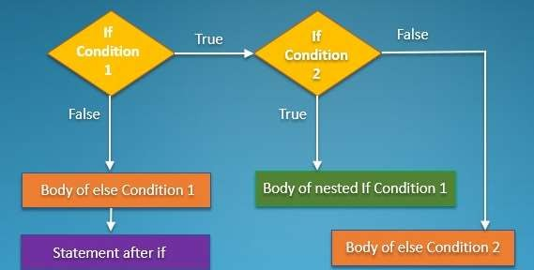
Nested if statement
The nested if statement represents the if block within another if block. Here, the
inner if block condition executes only when outer if block condition is true.
Syntax:
if(condition){
//code to be executed
if(condition){
//code to be executed
}
}
Check Program: Unit – 2 → NestedIfDemo.java

Slide 6
Multi way if… ladder if
The if-else-if ladder statement executes one condition from multiple statements.
Syntax:
if(condition1){
//code to be executed if condition1 is true
}else if(condition2){
//code to be executed if condition2 is true
}
else if(condition3){
//code to be executed if condition3 is true
}
...
else{
//code to be executed if all the conditions are false
}

Slide 7
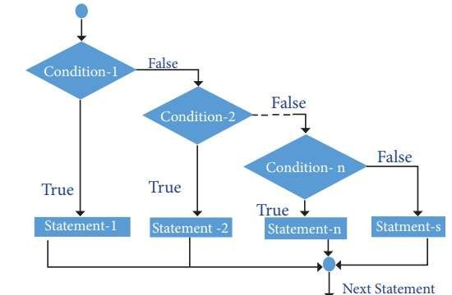
Multi way if… ladder if
The if-else-if ladder statement executes one condition from multiple statements.
Check Program: Unit – 2 → LadderIfDemo.java

Slide 8
Multi way if… ladder if
class IfElseLadder{
public static void main(String[] args)
{
// initializing expression
int i = 20;
// condition 1
if (i == 10)
System.out.println("i is 10\n");
// condition 2
else if (i == 15)
System.out.println("i is 15\n");
// condition 3
else if (i == 20)
System.out.println("i is 20\n");
else
System.out.println("i is not present\n");
System.out.println("Outside if-else-if");
}
}

Slide 9
Java Switch Statement
The Java switch statement executes one statement from multiple conditions. It is like if-else-if ladder statement. The switch statement works with byte, short, int, long, enum types, String and some wrapper types like Byte, Short, Int, and Long. Since Java 7, you can use strings in the switch statement.
In other words, the switch statement tests the equality of a variable against multiple values.
There can be one or N number of case values for a switch expression.
The case value must be of switch expression type only. The case value must be literal or constant. It doesn't
allow variables.
The case values must be unique. In case of duplicate value, it renders compile-time error.
The Java switch expression must be of byte, short, int, long (with its Wrapper type), enums and string.
Each case statement can have a break statement which is optional. When control reaches to the break statement, it jumps the control after the switch expression. If a break statement is not found, it executes the next case.
The case value can have a default label which is optional.
Check Program: Unit – 2 → SwitchDemo.java

Slide 10
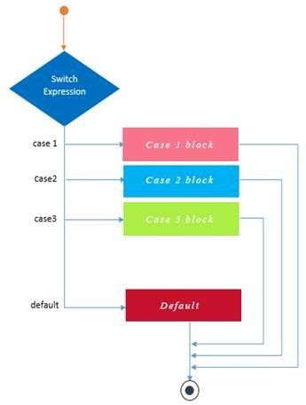
Java Switch Statement
Check Program: Unit – 2 → SwitchDemo.java

Slide 11
Java Switch Statement
public class SwitchDemo{
public static void main(String[] args)
{
int day = 5;
String dayString;
// switch statement with int data type
switch (day) {
case 1:
dayString = "Monday";
break;
case 2:
dayString = "Tuesday";
break;
case 3:
dayString = "Wednesday";
break;
default:
dayString = "Invalid day";
}
System.out.println(dayString);
}
}

Slide 12
Loops in Java
Loops can execute a block of code as long as a specified condition is reached.
Loops are handy because they save time, reduce errors, and they make code more
readable.
Java Supports :-
While loop
Do-while loop
for loop

Slide 13
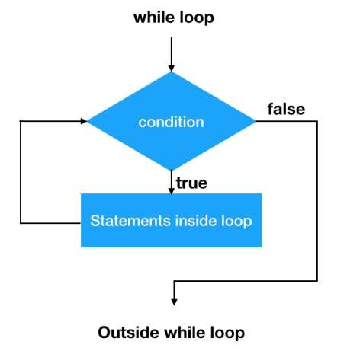
Java While Loop
The while loop loops through a block of code as long as a specified condition is true:
Syntax
while (condition) {
// code block to be executed
}
Check Program: Unit – 2 → WhileDemo.java

Slide 14
Java While Loop
public class WhileExample {
public static void main(String[] args) {
int i=1;
while(i<=10){
System.out.println(i);
i++;
}
}
}
class whileLoopDemo {
public static void main(String args[])
{
// initialization expression
int i = 1;
// test expression
while (i < 6) {
System.out.println("Hello World");
// update expression
i++;
}
}
}

Slide 15
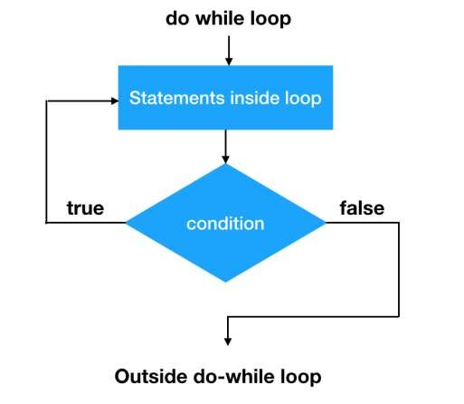
Java do.. While Loop
The do/while loop is a variant of the while loop. This loop will execute the code block once, before checking if the condition is true, then it will repeat the loop as long as the condition is true.
Syntax
do {
// code block to be executed
}
while (condition);
Check Program: Unit – 2 → DoWhileDemo.jav
a

Slide 16
Java do.. While Loop
public class DoWhileExample {
public static void main(String[] args) {
int i=1;
do{
System.out.println(i);
i++;
}while(i<=10);
}
}
public class DoWhileExample2 {
public static void main(String[] args) {
do{
System.out.println("infinitive do while loop");
}while(true);
}
}
Check Program: Unit – 2 → DoWhileDemo.jav
a

Slide 17
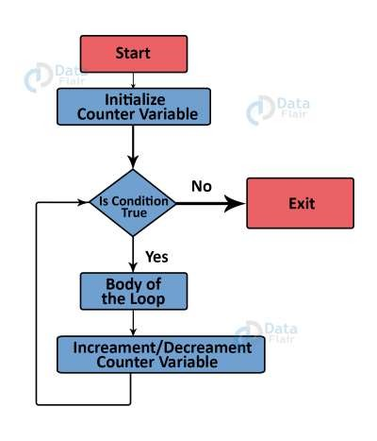
Java for Loop
When you know exactly how many times you want to loop through a block of code, use the for loop instead of a while loop:
Syntax
for (statement 1; statement 2; statement 3) {
// code block to be executed
}
Statement 1 is executed (one time) before the
execution of the code block.
Statement 2 defines the condition for
executing the code block.
Statement 3 is executed (every time) after
the code block has been executed.
Check Program: Unit – 2 → ForDemo.java

Slide 18
Java for Loop
class Test {
public static void main(String[] args) {
// for loop
for (int i = 1; i <= 10; ++i) {
// if the value of i is 5 the loop terminates
if (i == 5) {
break;
}
System.out.println(i);
}
}
}
Check Program: Unit – 2 → ForDemo.java

Slide 19
Java Scanner, If, While
import java.util.Scanner;
class UserInputSum {
public static void main(String[] args) {
Double number, sum = 0.0;
// create an object of Scanner
Scanner input = new Scanner(System.in);
while (true) {
System.out.print("Enter a number: ");
// takes double input from user
number = input.nextDouble();
// if number is negative the loop terminates
if (number < 0.0) {
break;
}
sum += number;
}
System.out.println("Sum = " + sum);
}
}
Check Program: Unit – 2 → ForDemo.java

Slide 20
Java Break statement
hen a break statement is encountered inside a loop, the loop is immediately terminated and the program control resumes at the next statement following the loop.
The Java break statement is used to break loop or switch statement. It breaks the current flow of the program at specified condition. In case of inner loop, it breaks only inner loop.
We can use Java break statement in all types of loops such as for loop,
while loop and do-while loop.
Check Program: Unit – 2 → BreakDemo.java

Slide 21
Java Break statement
public class BreakExample {
public static void main(String[] args) {
//using for loop
for(int i=1;i<=10;i++){
if(i==5){
//breaking the loop
break;
}
System.out.println(i);
}
}
}
1
2
3
4

Slide 22
Java continue statement
The continue statement is used in loop control structure when you need to jump/skip to the next iteration of the loop immediately. It can be used with for loop or while loop.
The Java continue statement is used to continue the loop. It continues the current flow of the program and skips the remaining code at the specified condition. In case of an inner loop, it continues the inner loop only.
We can use Java continue statement in all types of loops such as for loop,
while loop and do-while loop.
Cannot be used with Switch Statement
Check Program: Unit – 2 → ContinueDemo.java

Slide 23
Java continue statement
public class ContinueExample {
public static void main(String[] args) {
//for loop
for(int i=1;i<=10;i++){
if(i==5){
//using continue statement
continue;//it will skip the rest statement
}
System.out.println(i);
}
}
}
1
2
3
4
6
7
8
9
10

Slide 24
Break | Continue
The break statement is used to terminate the loop immediately. | The continue statement is used to skip the current iteration of the loop.
break keyword is used to indicate break statements in java programming. | continue keyword is used to indicate continue statement in java programming.
We can use a break with the switch statement. | We can not use a continue with the switch statement.
The break statement terminates the whole loop early. | The continue statement brings the next iteration early.
It stops the execution of the loop. | It does not stop the execution of the loop.

Slide 25
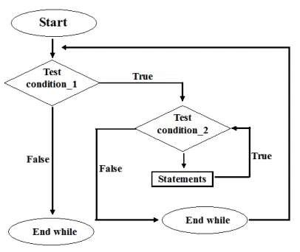
Java Nested Loop
If a loop exists inside the body of another loop, it's called a nested loop. Here's an example of the nested for loop.
int row,column;
// outer loop row = 1; while(row <= 3) { column=1;
// inner loop while(column <=row) {
System.out.println(row + “ “);
Column++;
}
System.out.println(“\n”);
row++;
} OUTPUT:- 1
2 2
3 3 3
Check Program: Unit – 2 → NestedForDemo.java

Slide 26
Java Nested Loop
class Main {
public static void main(String[] args) {
int rows = 5;
for (int i = 1; i <= rows; ++i) {
for (int j = 1; j <= i; ++j) {
System.out.print(j + " ");
}
System.out.println("");
}
}
}

Slide 27
Common mathematical methods
Min, Max, abs , log, sqrt method
Ex. Math.max(2.5, 3) returns 3.0
Math.min(2.5, 4.6) returns 2.5
Math.abs(-2) returns 2
Math.abs(-2.1) returns 2.1
The java.lang.Math class contains various methods for performing basic numeric operations such as the logarithm, cube root, and trigonometric functions etc.
Check Program : Unit – 2 → MathRandomDemo1.java

Slide 28
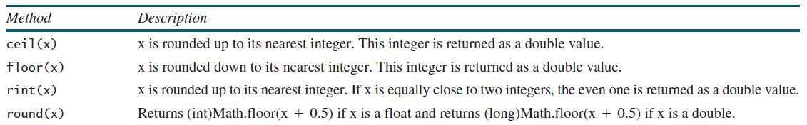
Common mathematical methods
Rounding methods
Ex. Math.ceil(2.1) returns 3.0
Math.floor(2.8) returns 2.0
Math.rint(2.5) returns 2.0
Math.round(2.6f) returns 3
Check Program : Unit – 2 → MathRandomDemo3.java

Slide 29
Common mathematical methods
Random method : This method generates a random double value greater than
or equal to 0.0 and less than 1.0 (0 <= Math.random() <1.0)
Ex.
(int)(Math.random() * 10) - - > Returns a random integer between 0 and 9. a + Math.random() * b - - > Returns a random number between a and a + b,
excluding a + b.
Ex. 50 + (int)(Math.random() * 99) - - > Returns a random integer between 50 And 99.
Check Program : Unit – 2 → MathRandomDemo.java

Slide 30
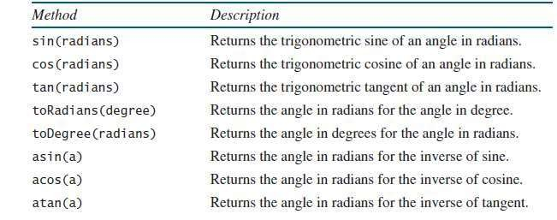
Common mathematical methods
Trigonometric methods in Math class
Ex. Math.toDegrees(Math.PI / 2) returns 90.0 Math.toRadians(30) returns 0.5236 (same as π/6) Math.atan(1.0) returns 0.785398 (same as π/4)
Check Program : Unit – 2 → MathRandomDemo2.java

Slide 31
Common mathematical methods
public class MathRandomDemo1
{
public static void main(String[] args)
{
double x = 28;
double y = 4;
// return the maximum of two numbers
System.out.println("Maximum number of x
and y is: " +Math.max(x, y));
// return the square root of y
System.out.println("Square root of y is: " + Math.sqrt(y));
//returns 28 power of 4 i.e. 28*28*28*28
System.out.println("Power of x and y is: " + Math.pow(x, y));
// return the logarithm of given value
System.out.println("Logarithm of x is: " + Math.log(x));
System.out.println("Logarithm of y is: " + Math.log(y));
// return the logarithm of given value when base is 10
System.out.println("log10 of x is: " + Math.log10(x));
System.out.println("log10 of y is: " + Math.log10(y));
// return the log of x + 1
System.out.println("log1p of x is: " +Math.log1p(x));
// return a power of 2
System.out.println("exp of a is: " +Math.exp(x));
// return (a power of 2)-1
System.out.println("expm1 of a is: " +Math.expm1(x));
}
}
Check Program : Unit – 2 → MathRandomDemo1.java

Slide 32
Common mathematical methods
public class JavaMathExample2
{
public static void main(String[] args)
{
double a = 30;
// converting values to radian
double b = Math.toRadians(a);
// return the trigonometric sine of a
System.out.println("Sine value of a is: " +Math.sin(a));
// return the trigonometric cosine value of a
System.out.println("Cosine value of a is: " +Math.cos(a));
// return the trigonometric tangent value of a
System.out.println("Tangent value of a is: " +Math.tan(a));
// return the trigonometric arc sine of a
System.out.println("Sine value of a is: " +Math.asin(a));
// return the trigonometric arc cosine value of a
System.out.println("Cosine value of a is: " +Math.acos(a));
// return the trigonometric arc tangent value of a
System.out.println("Tangent value of a is: " +Math.atan(a));
// return the hyperbolic sine of a
System.out.println("Sine value of a is: " +Math.sinh(a));
// return the hyperbolic cosine value of a
System.out.println("Cosine value of a is: " +Math.cosh(a));
// return the hyperbolic tangent value of a
System.out.println("Tangent value of a is: " +Math.tanh(a));
}
}
Check Program : Unit – 2 → MathRandomDemo2.java

Slide 33
Common mathematical methods
public class MathRandomDemo3 {
public static void main(String args[]) {
int i1 = 27;
int i2 = -45;
System.out.println("Absolute value of i1: " + Math.abs(i1));
System.out.println("Absolute value of i2: " + Math.abs(i2));
double d1 = 84.6;
double d2 = 0.45;
System.out.println("Round off for d1: " + Math.round(d1));
System.out.println("Round off for d2: " + Math.round(d2));
System.out.println("Ceiling of '" + d1 + "' = " + Math.ceil(d1));
System.out.println("Ceiling of '" + d2 + "' = " + Math.ceil(d2));
System.out.println("Minimum out of '" + i1 + "' and '" + i2 + "' = " + Math.min(i1, i2));
System.out.println("Maximum out of '" + i1 + "' and '" + i2 + "' = " + Math.max(i1, i2));
System.out.println("Floor of '" + d1 + "' = " + Math.floor(d1));
System.out.println("Floor of '" + d1 + "' = " + Math.floor(d2));
System.out.println("exp(" + d2 + ") = " + Math.exp(d2));
System.out.println("log(" + d2 + ") = " + Math.log(d2));
System.out.println("pow(5, 3) = " + Math.pow(5.0, 3.0));
System.out.println("sqrt(16) = " + Math.sqrt(16));
}
Check Program : Unit – 2 → MathRandomDemo3.java

Slide 34
END OF UNIT - 2

